Slide 1
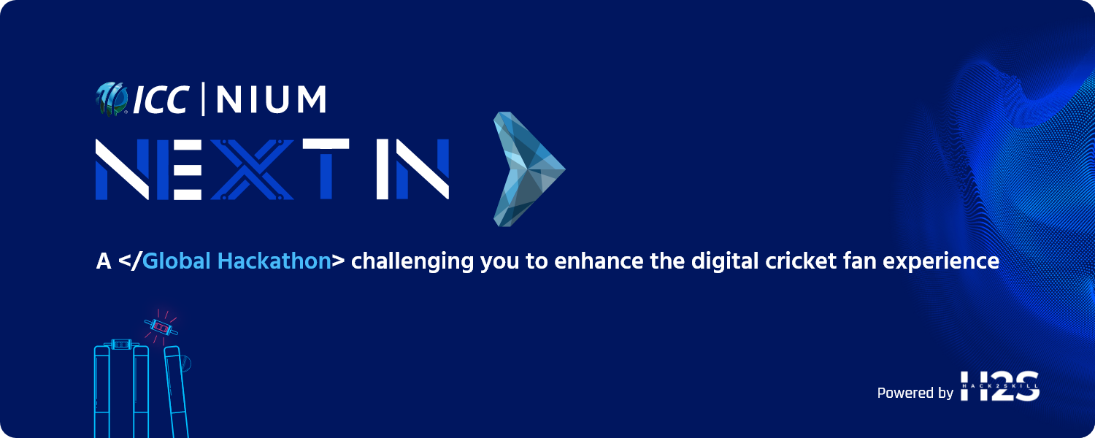

Team Name : SimLabs XR
Problem Statement : Fans to experience any ball in the history of the game in VR

Slide 2

Idea in Brief:
We are creating SmartBatter; a VR batting experience, where fans can select their most treasured occasions in the history of cricket such as Shane Warne’s Ball Of The Century, Lasith Malinga’s 4 in 4 or Murali’s unpickable Doosra and experience it first hand as a batsman in their living room. Successful completion will grant SmartBatter credit to the users. This SmartBatter credit can be used to purchase tickets to the ICC events, ICC merchandise and unlock other scenarios in the app.
For the prototype level these scenarios will be handpicked and made available.

Slide 3
Opportunity
Over 30 Million VR headsets sold in the world
Future Vision
A cricket fan’s world where you can play any ball in the history of the game in your living room.
A cricket fan’s world where you can live stream the deliveries of a live cricket game from anywhere in the world and play as a batsman. (Replication and modelling Hawkeye Trajectory data real-time in the SmartBatter cricket simulator)
https://www.grandviewresearch.com/industry-analysis/virtual-reality-vr-market
https://www.statista.com/outlook/amo/ar-vr/india#:~:text=Revenue%20in%20the%20AR%20%26%20VR,US%24211.30m%20in%202023.
Over 2 Billion cricket fans in the world
VR Market growth in India is projected at 14.63%
Global VR market was valued at 21 Billion USD
The only way for a cricket fan to engage and experience the same delivery that is bowled at the centre wicket is through video analysis and replay. We go a step further by replicating and modelling the same delivery in the VR.
This is not just a video, but a real time simulation of the scenario. Cricket fans can put themselves in the position of a professional batsman and play the deadly in swinging Yorkers. Successfully completing these challenges will give users access to tickets to ICC events and other ICC merchandise. This then closes the loop on fan engagement and ties it back to ICC event promotion and sales.

Slide 4
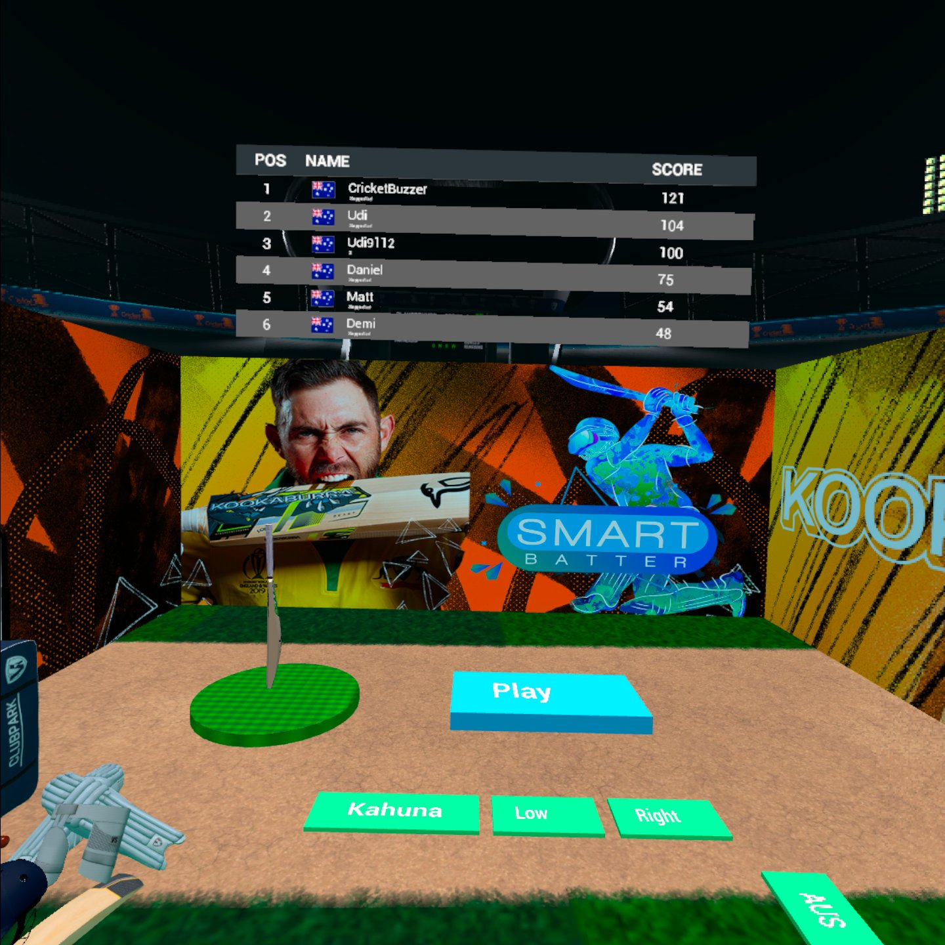
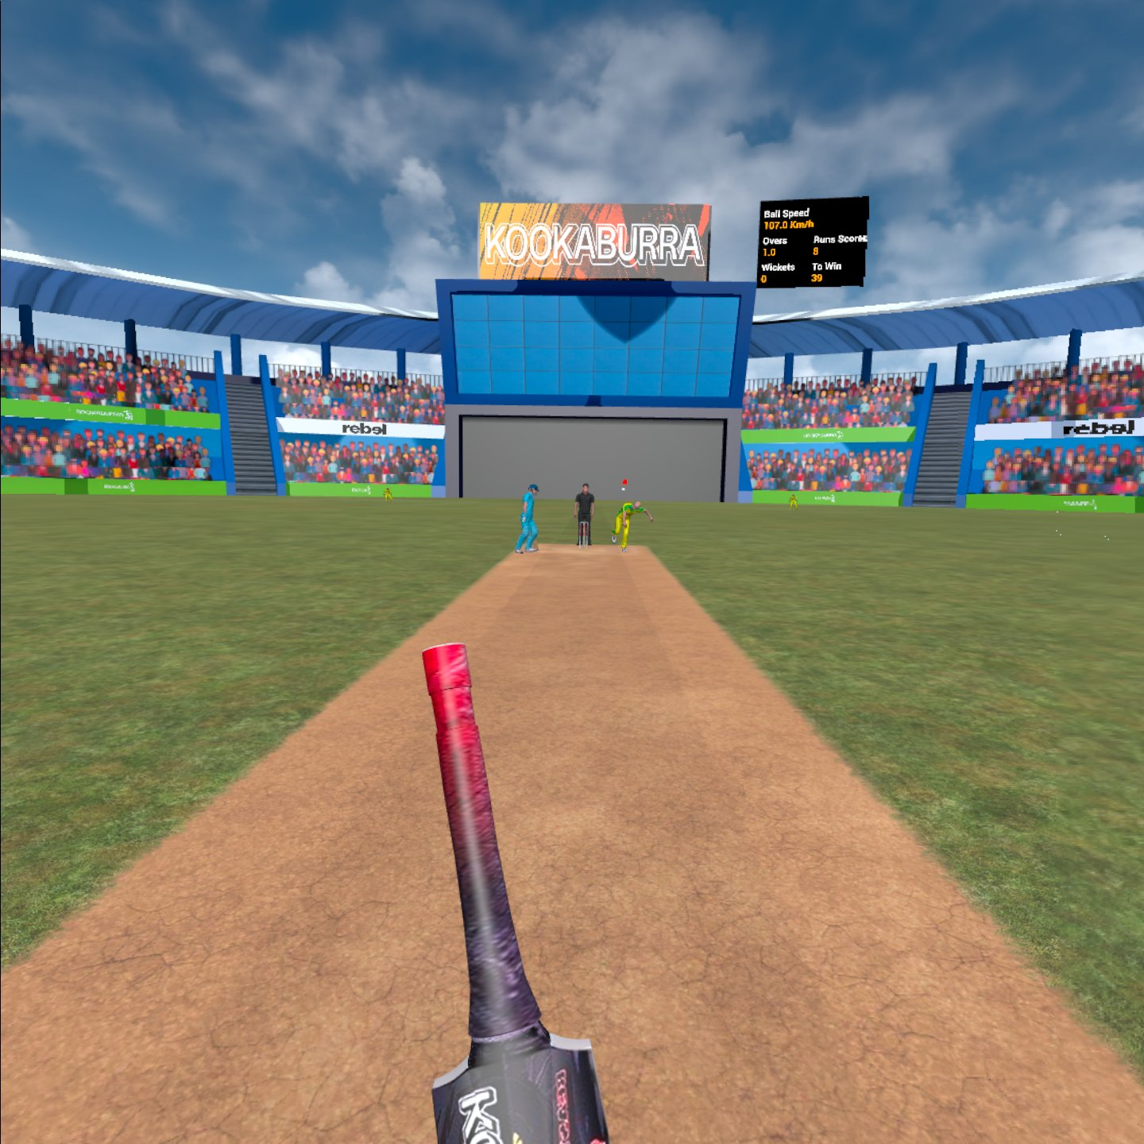
SmartBatter Features
Challenge Mode
Scenario Selection
Shane Warne’s ball of the century - https://www.youtube.com/watch?v=JwVR28XbZx8
Brett Lee’s Hattrick in World Cup 2003 against Kenya - https://www.youtube.com/watch?v=BV4mcit0xqQ
Murali’s unplayable Doosra - https://www.youtube.com/watch?v=NdzpcKCv7Ow
James Anderson 10 /45 at Headingly against Sri Lanka - https://www.youtube.com/watch?v=D1SWRq6YVNs
Once each scenario is completed the actual footage of the video will be played within VR for the user to compare his skills and abilities.
When the user completes the above challenges, they will receive SmartBatter credit where they can unlock other scenarios which are unavailable by default.
The credit can also be used to purchase other items such as Tickets to ICC Events, ICC merchandise – Caps, T-shirts, Team Jerseys etc.

Slide 5
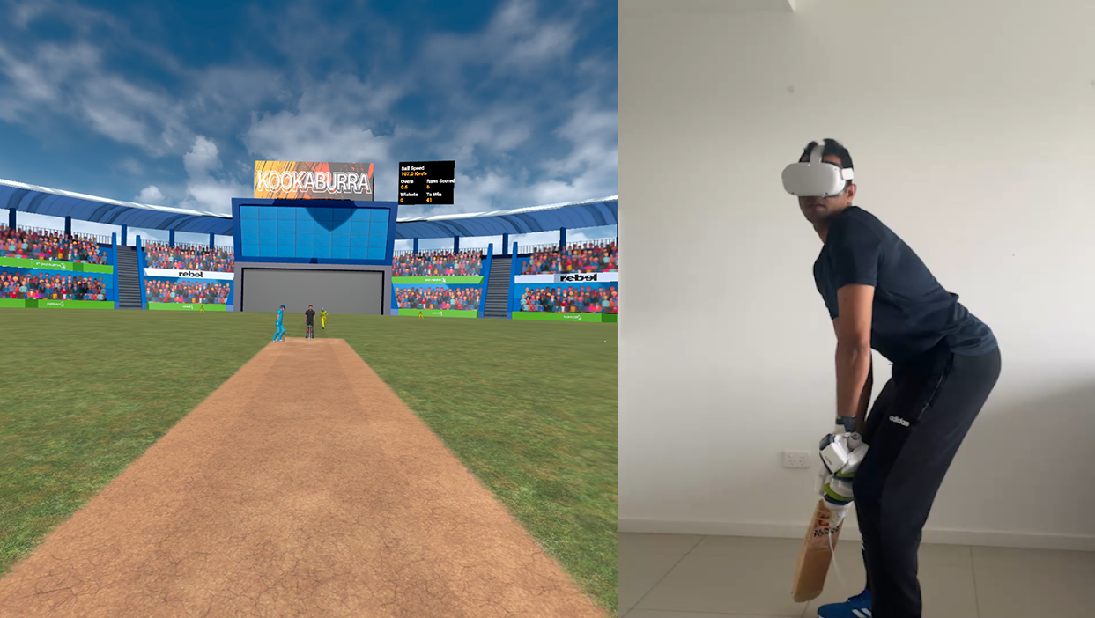
Business Logic of the solution :
- SmartBatter is a VR App launched on the Oculus Quest Headset
- The Left Controller is attached to a bat (any cricket bat)
- When the user launches the app:
- The user is directed to a home screen
- In the Home Screen, user can select the following:
- Play unlocked scenarios by default
- Chase a competitive score for T10 / T20
If SmartBatter credit is gained the user can unlock new scenarios
Real-Time Side by Side Comparison

Slide 6
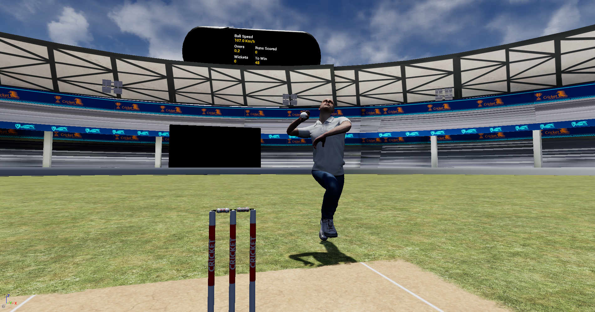
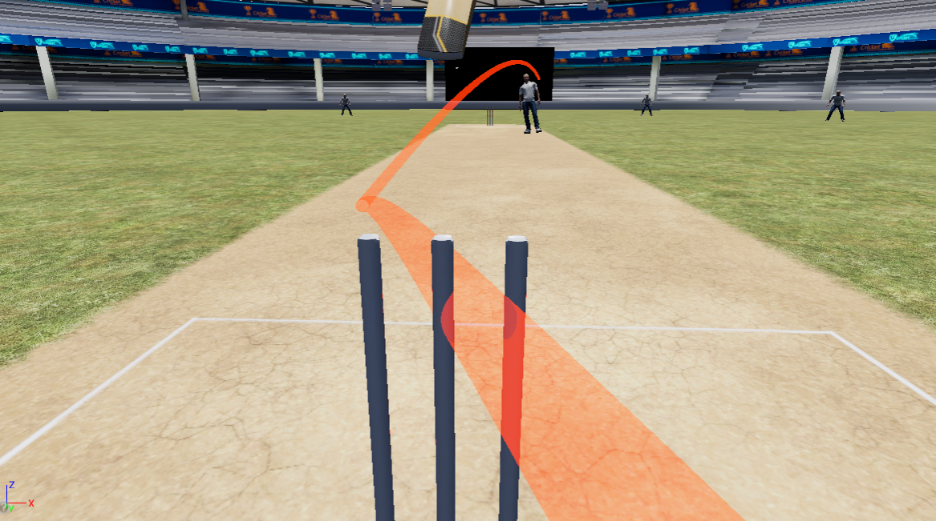
Business Logic of the solution (Cont.):
Challenge Mode
Generic bowler model asset with generic animations
Runs in and bowls the delivery(ies)
These deliveries are modelled according to the SmartBatter projectile motion algorithm
The algorithm considers the following:
Pace, Swing, Line, Length, Magnus
Bounce
Friction of the surface
Fielding for each delivery is AI driven

Slide 7
Business Logic of the solution (Cont.):
Challenge Mode
Deliveries for the challenge mode are constructed for simulation through video analysis and iterative testing through the SmartBatter projectile motion algorithm which is specific to simulate the trajectory of a delivery.
Future Vision
The future vision for the historical data simulation is to integrate with Hawkeye Ball Trajectory data to the SmartBatter projectile motion algorithm. This way we can eliminate the iterative testing of the simulation of historical data.
We propose that every cricketing event should have a SmartBatter demo location (MCG, SCG, Lords, Eden Gardens, Wankhede Stadium), where fans can engage and face their favourite bowler.

Slide 8
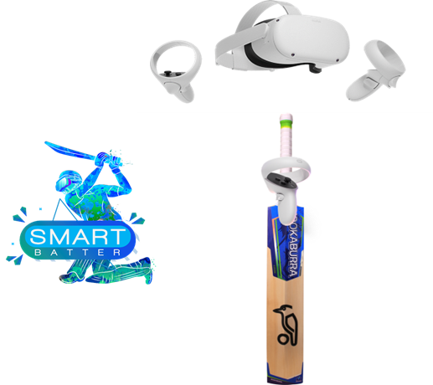


Technology used :
Unreal Engine - is used to complete the logic development and the integration through to the Oculus Quest Headset. Unreal Engine is a game development engine which supports game development and simulation behavior development.
Android Development Environment- Is used to pack the files as a deployable version to the Oculus Quest Headset. The Quest headset is Android based.
Blender will be used to do any asset modification needs during the development of the game assets
Photoshop will be used to reskin and add artwork to the game environment
The Oculus Quest controller will be used as the tracker for the bat.

Slide 9
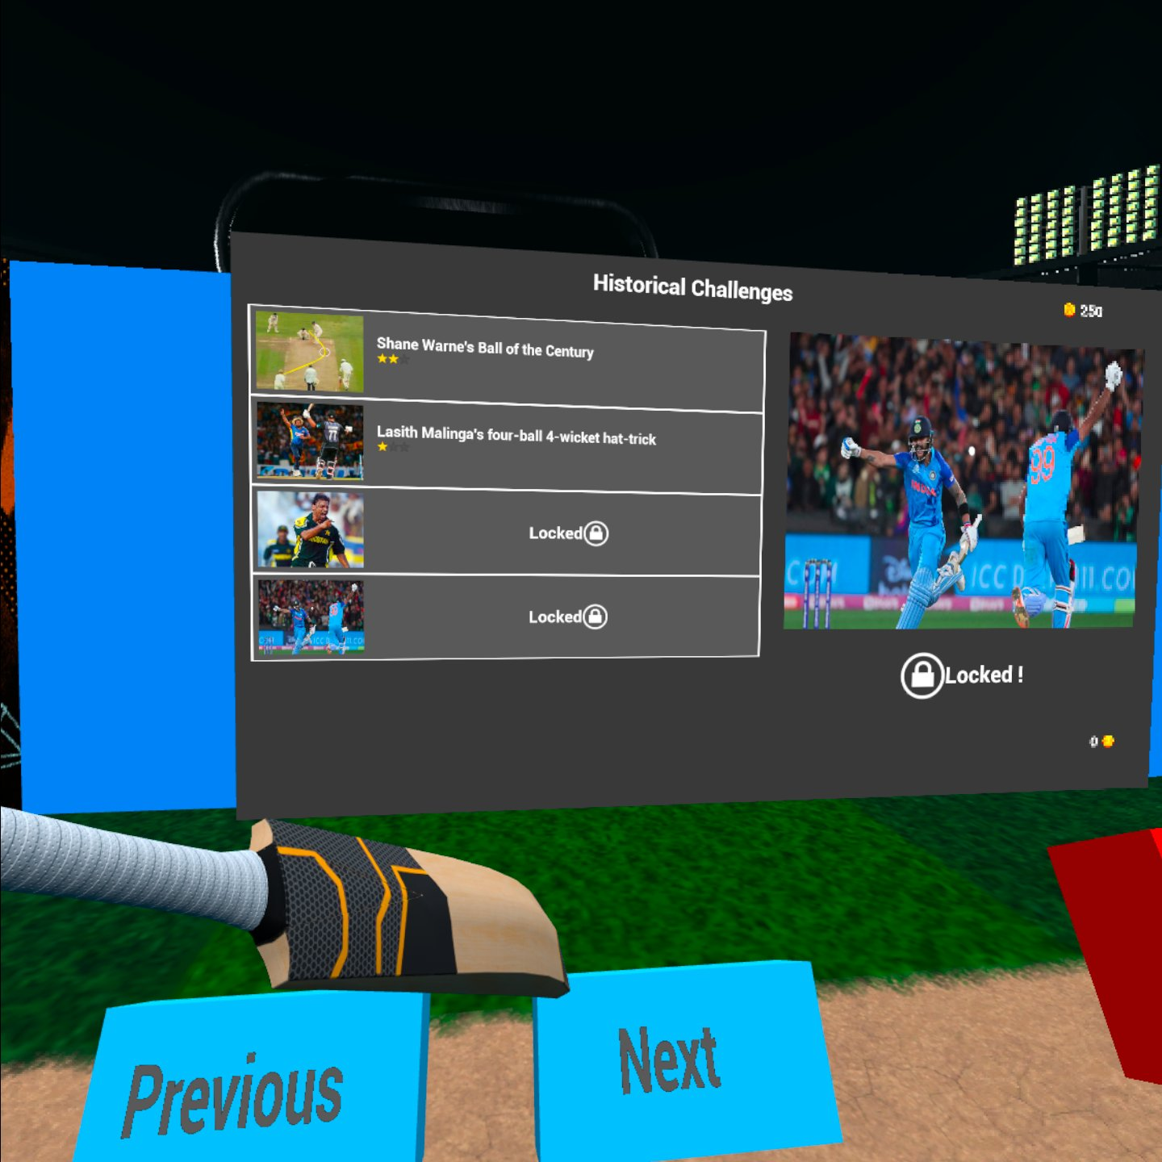
Prototype Updates:
Challenges are built into the dashboard
Every Challenge is locked and can be unlocked by SmartBatter coins
These challenges are based on real scenarios and modelled based on the video analysis of each scenario.
The trajectory of each delivery in the scenario is modelled interfaced with our Trajectory Calculation Algorithm.
Estimated cost of/after implementing the solution :

Slide 10
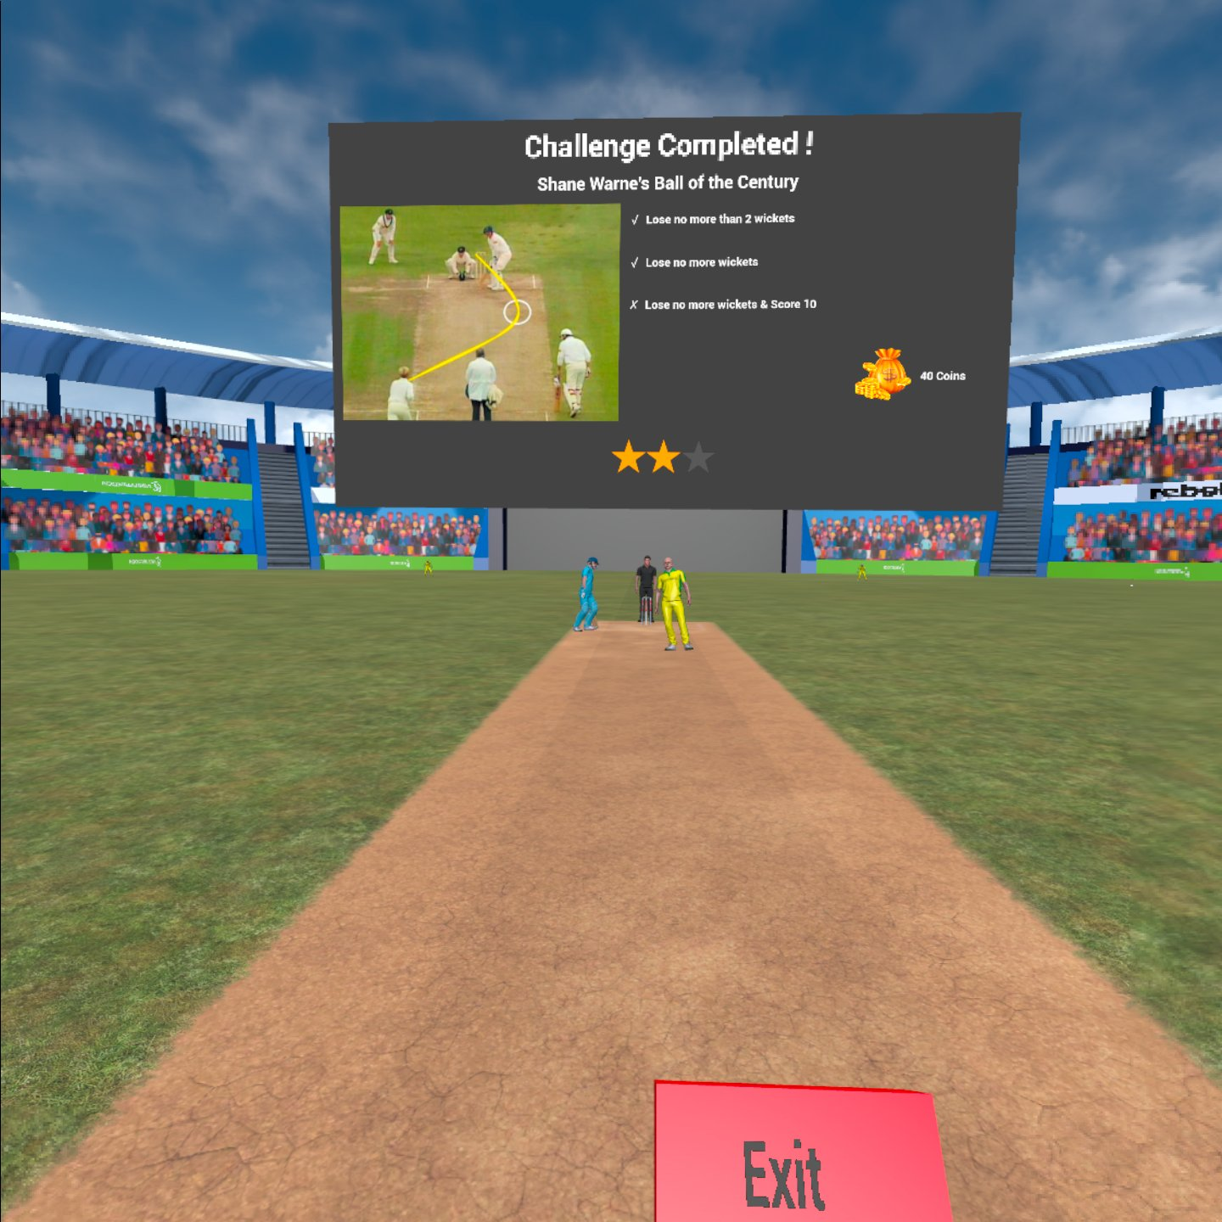
Prototype Updates:
Challenge completion is evaluated under many parameters
Shane Warnes ball of the century is evaluated based on whether the user
1. Loses no more than 2 wickets
2. Loses no more wickets and score 10 runs
Meeting this guidelines will provide the user the capability of winning more SmartBatter coins.
Estimated cost of/after implementing the solution :

Slide 11
Prototype Updates:
At the end of the challenge the users can see the rating of their performance by the number of stars.
When the user completes the challenge, they will be awarded points based on their performance, and success of the challenge completion
This will be the earning which the user can utilize to unlock other scenarios or purchase ICC Event Tickets
The users can play one scenario many times to gain more SmartBatter coins.
Estimated cost of/after implementing the solution :

Slide 12
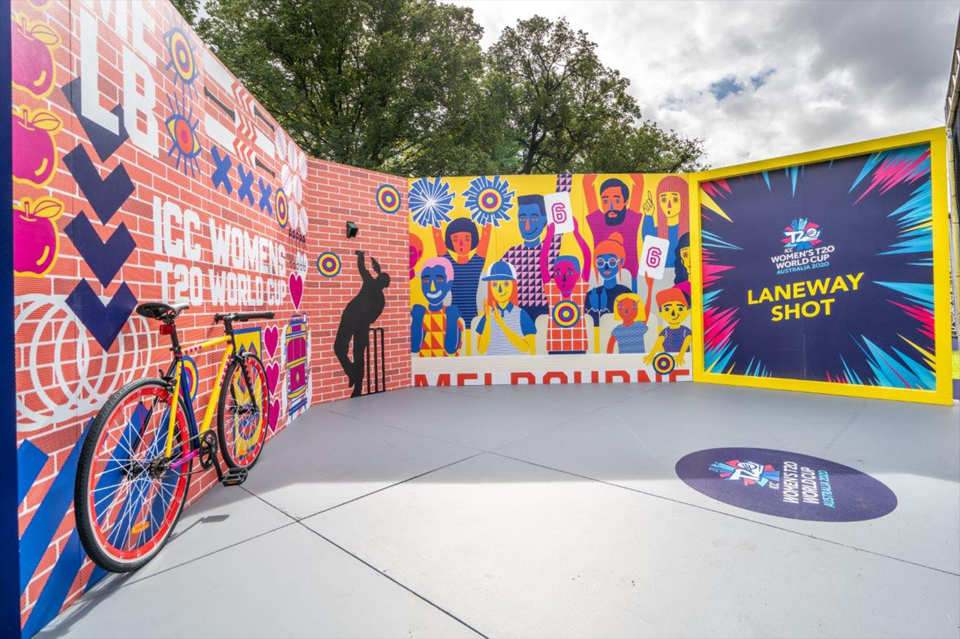
SmartBatter Simulator Modules
Stand Alone Simulator APP
Stand Alone app will be used by users at leisure like a VR Cricket Game to play any scenario in the history of the game
Mobile Simulator
These can be stationed at ICC events, Fan Areas for fans to use and be more engaged with the sport. Immerse themselves in the situation as the Pro’s.
Static Simulator
Stationed at all major Cricket Stadiums and can be booked for a session. Different scenarios can be ticketed at different prices based on importance and appeal.
Estimated cost of/after implementing the solution :

Slide 13

SmartBatter Revenue Model
Stand Alone Simulator APP
The App is free to use
There will be scenarios which are unlocked by default
As the user plays the scenarios, they have the capability of unlocking the scenarios, bats, digital collectibles, Tickets for the ICC events and other cricketing events.
SmartBatter will run ads after each over of the scenario which will be the revenue.
From this ad revenue SmartBatter will pay ICC for the tickets.
When the user successfully completes a scenario, then we would prompt the user to buy a digital collectible of the scenario which will donate 50% of it to the nations which are building the sport, and we would get the professional player pertaining to the scenario to sign some merchandise to be sent off to the user.
The scenarios and other accessories such as bats, jersies for the avatars, and stadiums such as MCG, SCG or Lords can be purchased.
Estimated cost of/after implementing the solution :

Slide 14
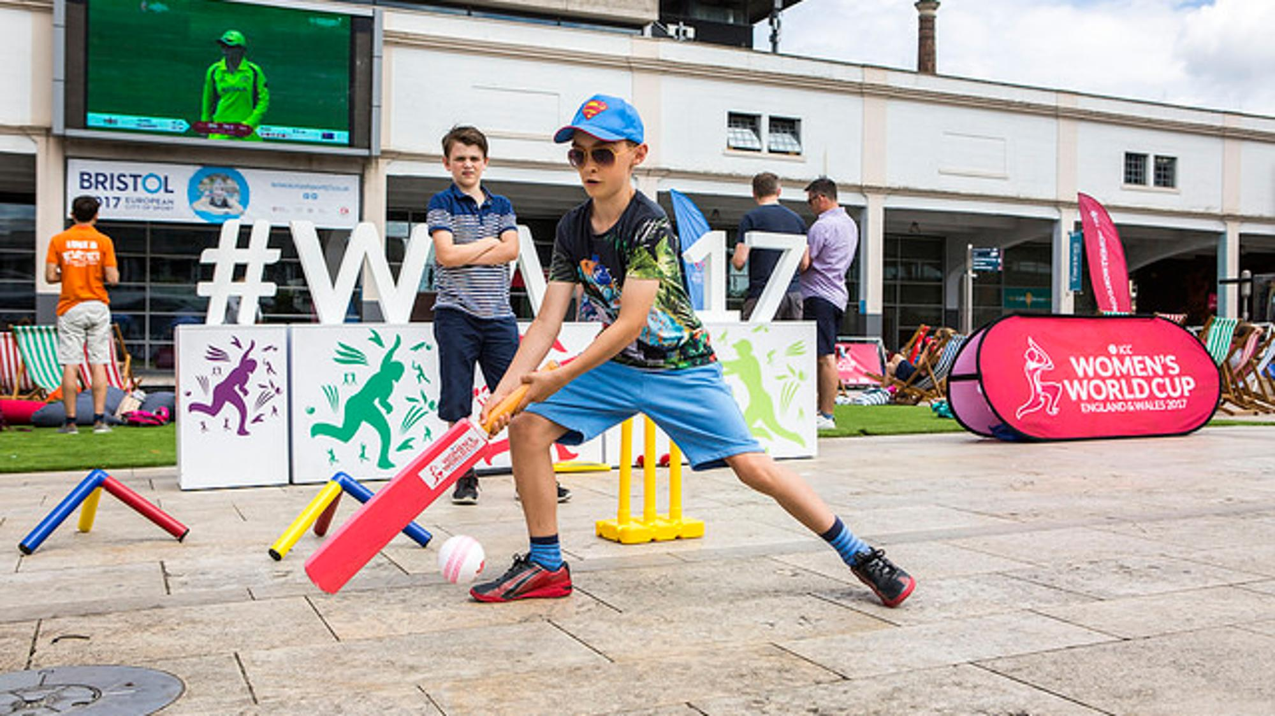
SmartBatter Revenue Model
Mobile Simulator
The Simulator is purchased at a subscription for ICC events or any other Cricket Event; ie: Ashes
Selected scenarios will be running
If there are added scenarios needed, ICC or the Sporting event coordinating stakeholder will pay for the scenario development.
Fans at the venues can experience some live, immersed action on the simulator.
This will create positive PR and more immersed fan engagement for the sport.
Estimated cost of/after implementing the solution :

Slide 15
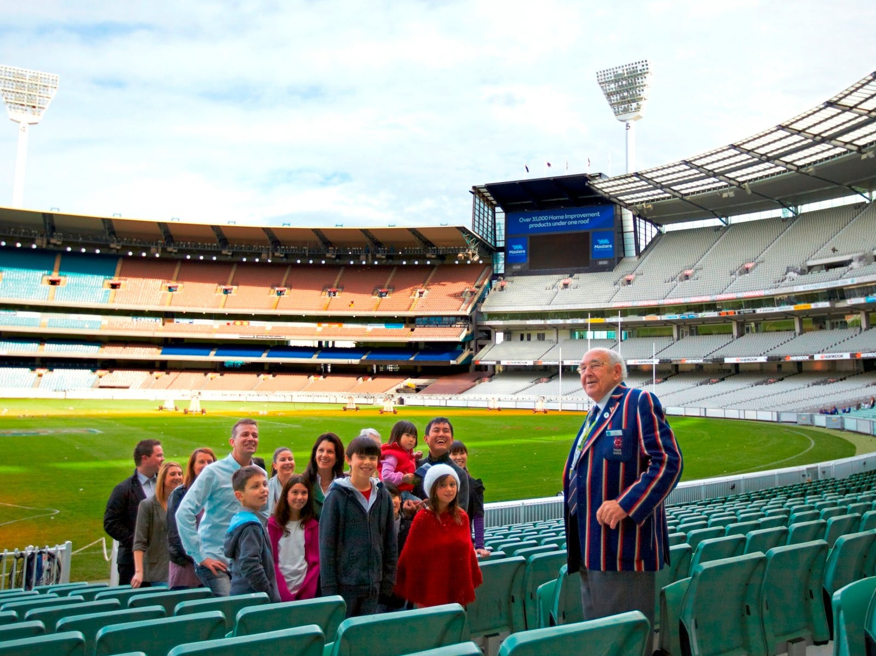
SmartBatter Revenue Model
Static Simulator
The simulator will be stationed at major cricket grounds such as MCG, SCG, and Lords
The venue will pay a subscription fee to SmartBatter for being available at the venue. This means that the venue needs to do the marketing for the simulator.
Public can book for a session at the Cricket Simulator similar to the major cricket grounds tours.
The users can select which scenario they need from a selected set of scenarios and get immersed in the history of cricket.
Estimated cost of/after implementing the solution :

Slide 16
Estimated cost of/after implementing the solution :
Cost for the Future Vision
Task / Action | Cost of Implementation
Game Design, Development and Integration Efforts for 20 Selected scenarios (Generic Animations) | 10,000 USD
Specific Animations (per bowler) | 2000 USD
Each Additional Scenario (Minimum 6 Deliveries) | 1000 USD
Hawkeye Data retrieval, analysis, and smoothing | Royalties 10% or Equivalent (Estimated)
Estimated cost of/after implementing the solution :

Slide 17
